Slide 1
2014-2016 VERSTA's Jussara-Palm AF Project and 2016 Project Plan by Japan Fund for Global Environment Ver.2.1
Date:Sep21.2016
Place: NUS Enterprise
Vice President, IFSJ
Managing Director, The NPO VERSTA
Ph.D. Yosikazu Onose
Mail : yoshi-o@tkg.att.ne.jp
Web : http://www.versta.org/

Slide 2
Contents
1.Principle of The NPO VERSTA’s activity
2.Background of The NPO VERSTA’s activity
3.Overview of The NPO VERSTA
4.2012-2013 The NPO VERSTA’s activities
5.2014-2016 The NPO VERSTA’s activity Plan
6.2014-2016 The NPO VERSTA’s activity Results
7.2014 The NPO VERSTA’s activities
8.2015 The NPO VERSTA’s activities
9.2016 The NPO VERSTA’s activities
10. Conclusion:Business partnership program with The NPO VERSTA’s activities
◆Speaker Profile

Slide 3
1.Principle of The NPO VERSTA’s activity
The ultimate goal of this project is that to achieve the prevention of global warming through the conservation of the Atlantic coastal forest (Mata Atlãntica) in Brazil that has been harvested 93% by the agricultural development.
Our Principle：The NPO VERSTA was established to contribute to the realization of a low-carbon society and the promotion of sustainable global environment maintenance.

Slide 4
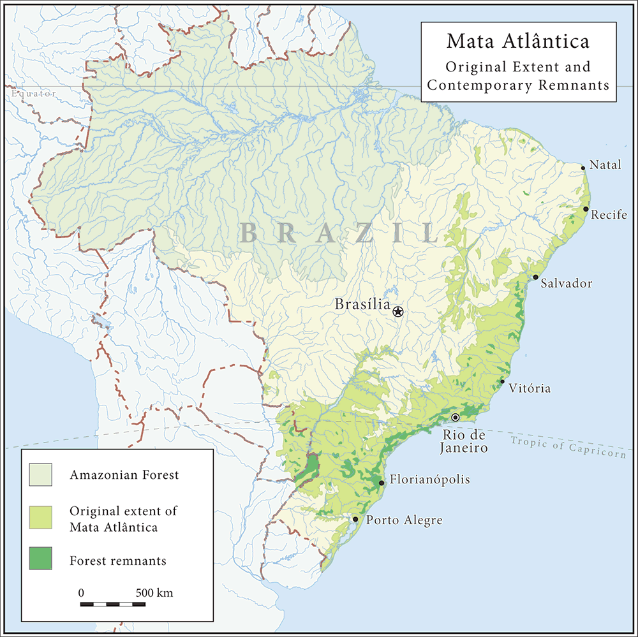
1.Principle of NPO VERSTA’s activity
131million ha
13 million ha
Sete Barras

Slide 5
2.Background of NPO VERSTA’s activity
Brazil is the country of the world's largest Japanese immigrants, about 260,000 Japanese went to Brazil before World War II through the postwar period.
Today, Japanese people are eating delicious coffee , orange, and chicken of Brazil.
However, the Atlantic forest (Mata Atlãntica) and the Amazon of Brazil has continued to the present decrease of tropical rainforest by developing large-scale illegal logging and due to delays in improving the lives of local residents, if you leave it, Brazilian rainforest that has been concern can be reduced significantly.

Slide 6
3.Overview of The NPO VERSTA
Our Mission：We support the spread of agroforestry attracting global attention to the use of sound agricultural methods to help reproduction and the maintenance of key natural environments such as tropical rain forests.
Our Activities:
The 1st Step: Agroforestry support charity Live
(AF AID)&Music Distribution
The 2nd Step: Agroforestry point enterprise (AF
POINT)
The 3rd Step: Agroforestry support projects
The 4th Step: Promotion of Agroforestry home &
product attestation.

Slide 7
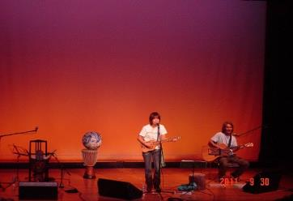
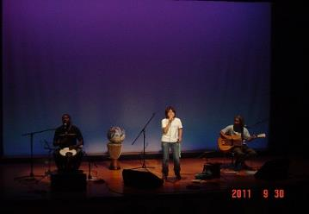
3.Overview of The NPO VERSTA
“AF AID Vol.2″
Date：Fri., September 30, 2011 OPEN 18:30/START 19:00
Place ：Nihombashi social education hall 8F,Tokyo,JAPAN
Part I: Video Lecture “Agroforestry”
Lecturer/Dr. Masaaki Yamada,
Assistant Professor ,TUAT
Part II: Special Live
Singer/ Takako Sirai

Slide 8
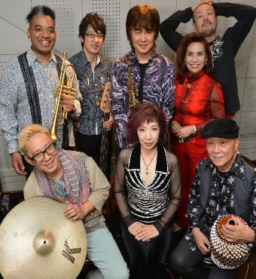
3.Overview of The NPO VERSTA
“Music Delivery″
Date：From Oct., 2014
Artist : Jazz Pinist Ritsuko Endo@FRV
Mechanisms: Ritsuko Endo has decided to agree with the spirit of the activity VERSTA, is carried out worldwide delivery of music, make donations to VERSTA activities 1% of its sales.
Current situation :Music fans around the world have enjoyed with such as downloading and streaming Ritsuko Endo’s CD music from the Music Delivery site. Most access to often is Taiwan.

Slide 9
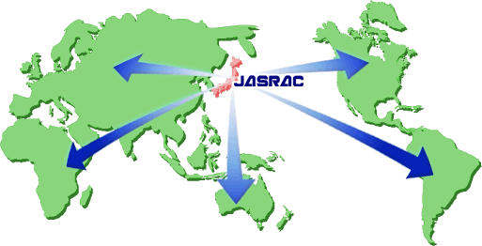
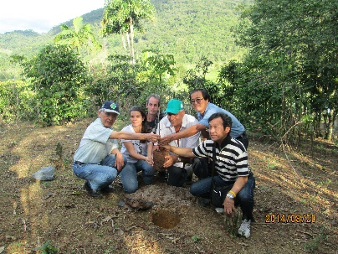
3.Overview of The NPO VERSTA
1% of the Internet world delivery sales of Ritsuko Endo CD sound source has been donated to VERSTA.
“Music delivery leads to AF″
Registration permission
Registration application
Original usage fee payment
1% distribution
Downloads
Streaming
Original use fee
Music usage fee payment

Slide 10
4.2012-2013 The NPO VERSTA’s activities
2012 our activity : Our project was carried out AF promotion project by 2012 Japan Fund for Global Environment(\1,600,000).
2012 our actual results : By the Jussara-Palm AF promotion PJ meeting and pilot project act in Rio Preto village, Sete Barras city, Sao Paulo state, the following subjects became apparent.
1) The need for soil improvement by appropriate
fertilization
2) Possibility of organically grown coffee mixed planting
by Jussara-Palm AF
3) Development of Jussara-Palm fruit pulp processing
technology
4) Potential as a raw material for nutrition food and
health food of Jussara-Palm fruit pulp
5) Possibility of Pau Brazil mixed planting cultivation that
is a tree of Brazil country originated etc.

Slide 11
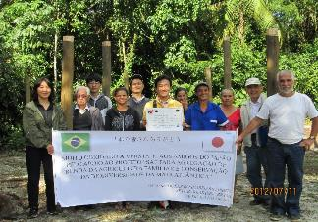
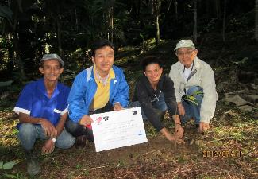
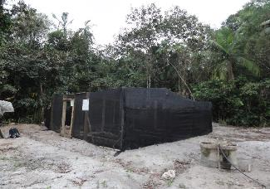
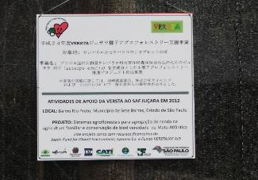
4.2012-2013 The NPO VERSTA’s activities
・2012 Activities photographic recorded

Slide 12
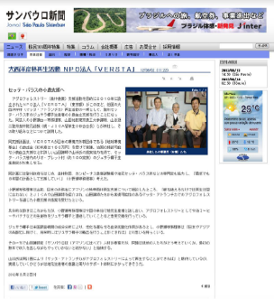
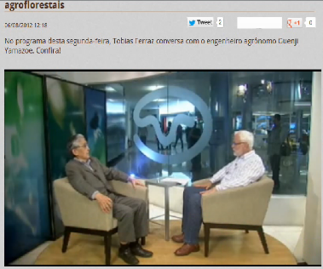
4.2012-2013 The NPO VERSTA’s activities
・2012 media recorded
◆Sao Paulo newspaper electronic version （August 2, 2012)
◆TV-TERRAVIVA’s30 minutes special program of TV-BAND (August 6, 2012)

Slide 13
4.2012-2013 The NPO VERSTA’s activities
・ Anti-aging component of Jussara-Plam of VERSTA agroforestry comparison with Brazilian fruit
Brazilian fruit（Excerpt） |  | Total anthocyanins (mg/100 g fresh matter) | Extractable polyphenols （mg GAE/100 g） | Yellow flavonoids (mg/100 g fresh matter)
Name | Breed
Acerola | Malpighia emarginata | 18.9 ± 0.9 | 1063 ± 53.1 | 9.6 ± 1.4
Camu-camu | Myrciaria dubia | 42.2 ± 17.0 | 1176 ± 14.8 | 20.1 ± 4.4
A:Açaí, assai | Euterpe oleracea | 111 ± 30.4 | 454 ± 44.6 | 91.3 ± 20.6
B：Juçara, Jussara | Euterpe edulis | 192 ± 43.2 | 755 ± 8.3 | 375 ± 87.6
B/A（％） |  | 173.0 | 166.3 | 410.7
Function |  | ・Antioxidant action (Prevention arteriosclerosis, cerebral infarction ) ・Suppression of muscle fatigue | ・Antioxidant action ・Hormone promoting action | ・Antioxidant action ・Antibacterial and anti-virus ・Hormone promoting action
Reference：Maria do Socorro M. Rufino and other author“Bioactive compounds and antioxidant capacities of 18 non-traditional tropicalfruits from Brazil”,Food Chemistry 121 (2010) 996–1002

Slide 14
4.2012-2013 The NPO VERSTA’s activities
2013 our actual results :Our project was carried out AF promotion project by pre chairman Mr. Matsutaro Morita’s Donation( ¥ 200,000)of The NPO VERSTA.
By this donation, VERSTA conducted a follow-up guidance the following.
1) Dr.&Professor Fernando of San Carlos
Federal University was carried out Rio Preto
village’s Jussara palm growing AF follow-up
guidance.
2)Project team bought 100 pieces stem crop
seedlings, fertilizer, mowing the electric
machine etc..

Slide 15
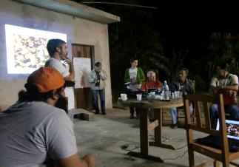
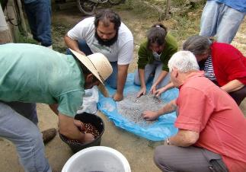
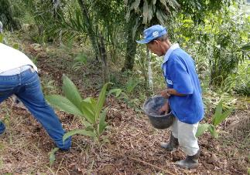
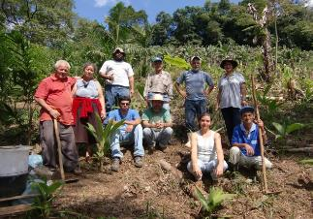
4.2012-2013 The NPO VERSTA’s activities
・2013 Activities photographic recorded

Slide 16
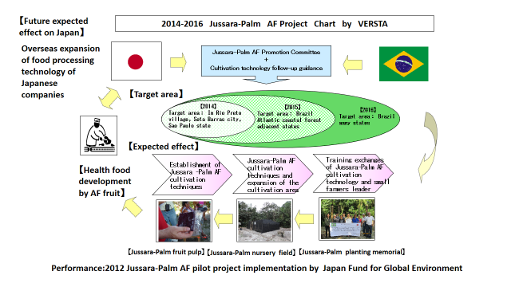
5.2014-2016 The NPO VERSTA’s activity Plan

Slide 17
6.2014-2015 The NPO VERSTA’s activity Results
Our activity results : Our project is carry out using Japan Fund for Global Environment
(2014\2,000,000+2015\2,000,000).
The breakdown of Our activity results:
1) VERSTA Jussara palm AF joint project meeting
(2014\1,000,000+2015\700,000).
2) VERSTA Jusara palm AF model field installation
(2014\400,000+2015\340,000).
3) VERSTA establishment of Jussara AF palm
cultivation technology(2014\480,000+
2015\800,000).
4) VERSTA Jussara palm AF spread enlightement
activities(2014\120,000+2015\160,000).

Slide 18
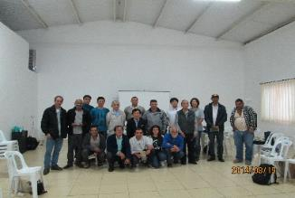
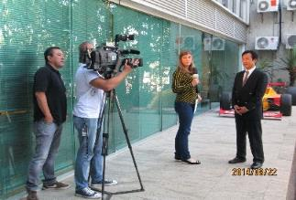
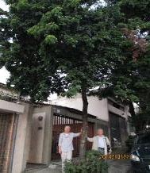
7. 2014 The NPO VERSTA’s activities
・2014 Activities photographic recorded
←Left of the photo is Pau Brazil and stringed instrument bow fabricator Mr. LOMBARDY.

Slide 19
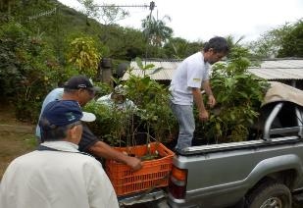
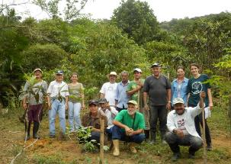
7. 2014 The NPO VERSTA’s activities
・2014 Activities photographic recorded

Slide 20
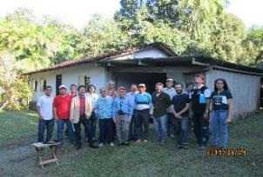
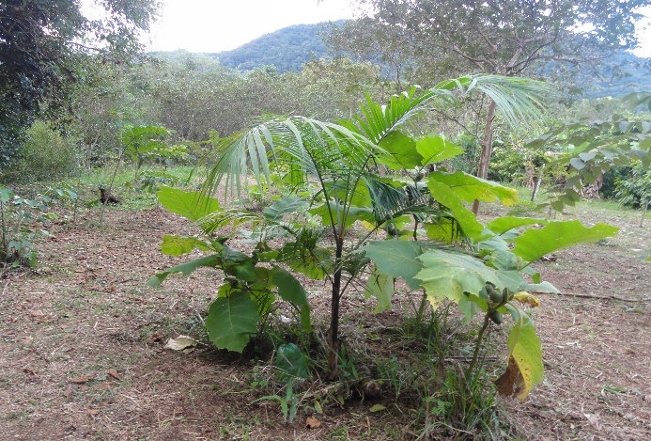
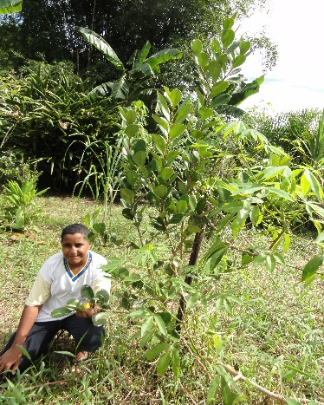
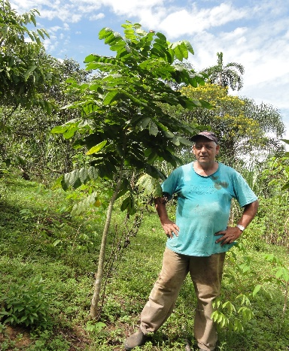
8. 2015 The NPO VERSTA’s activities
・2015 Activities photographic recorded

Slide 21
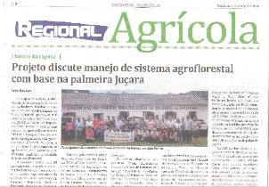
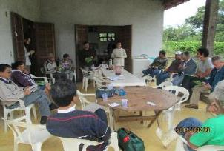
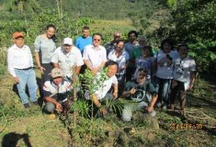
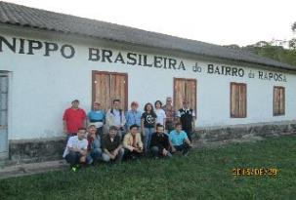
8. 2015 The NPO VERSTA’s activities
・2015 Activities photographic recorded

Slide 22
9. 2016 The NPO VERSTA’s activities
2016 our activity Budget : Our project is carry out AF promotion project using 2016 Japan Fund for Global Environment(\2,000,000).
2016 our activity plan:
1) VERSTA Jussara palm AF joint project meeting
and AF technology exchange in Rapoza model
field with small farmers in Rio Preto in Sete Baraas
and Agricultural Instructors (\580,000).
2) 2016 VERSTA Jusara palm AF model field
installation(\410,000).
3) 2016 VERSTA establishment of Jussara AF palm
cultivation technology(\900,000).
4) 2016 VERSTA Jussara palm AF spread
enlightenment activities(\110,000).

Slide 23
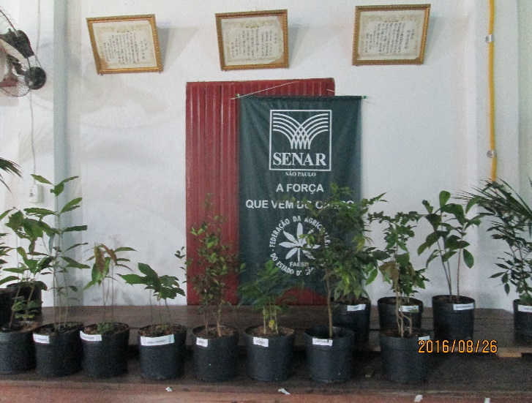
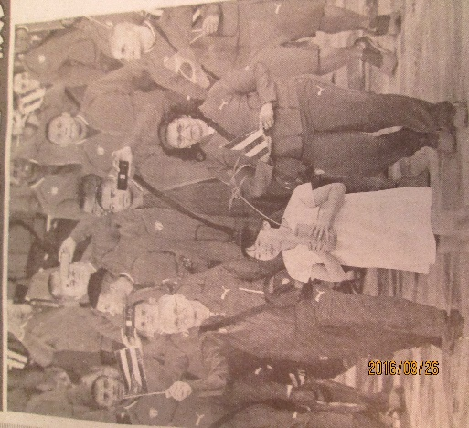
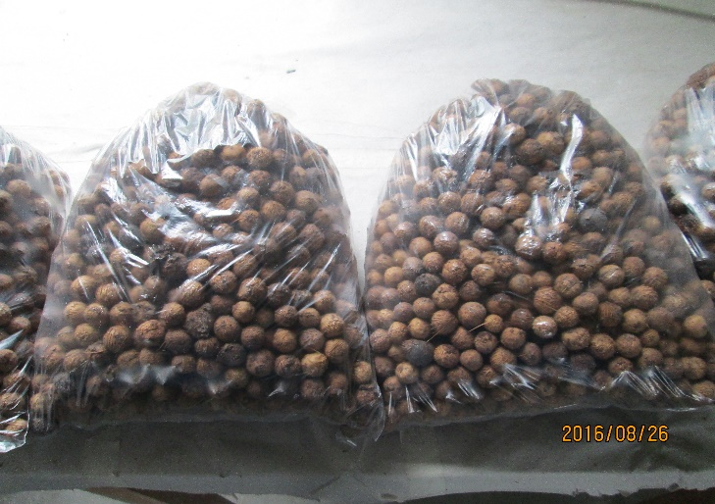
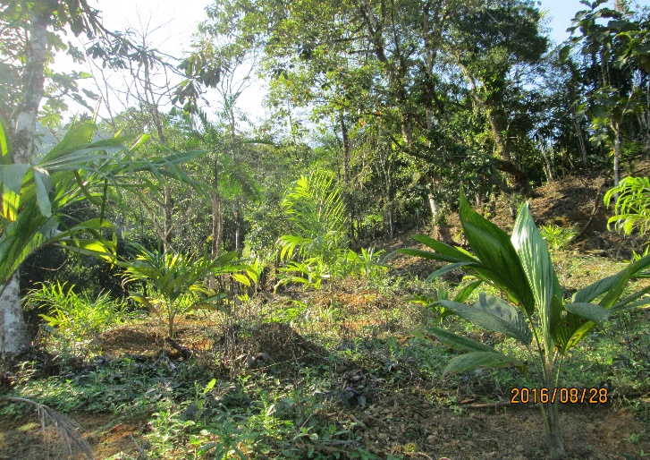
9. 2016 The NPO VERSTA’s activities
・2016 Activities photographic recorded
Rio Olympic
Jussara Palm

Slide 24
10. Conclusion : Business partnership program with The NPO VERSTA’s activities
Join as a supporting member company: Annual membership fee mouthful 50,000 yen(≒ US$500) or more as part of the CSR activities of the companies. 50,000 yen is equivalent to Jussara palm seedlings 100 bounden duty.
Participation as a sales tie-up company of Jussara palm-related products: Jussara palm fruit is the highest anti-aging ingredient in the Brazilian fruit. You can participate as a sales tie-up companies of the functional food and the health food by Jussara palm fruit. However, the condition can become a supporting member company.

Slide 25
By 2014-2016 Japan Fund for Global Environment NPO VERSTA’s the agroforestry promotion project
Thank you for your attention.

Slide 26
◆Speaker Profile
Name：Ph.D. Yoshikazu Onose
Address：Mitaka-shi, Tokyo , JAPAN
Affiliation： Vice President NPO Tokyo IT Coordinator , Managing Director NPO VERSTA , Lecturer of Sanno University Service Learning Center, Lecturer of Department of Commerce International Business of Takushoku University
Education level ：Completed doctoral Takachiho University Graduate School of Business
Degree：Doctor of Business Administration, Takachiho University （Ph.D.）
Qualification：Registered Management Consultant, Certified Systems Auditor, IT Coordinator, evaluator independent evaluation organization and Human Services , Provisional Auditor of ISO27001（ISMS）Other
Biography：After graduating from university, through measurement company marine environment, food industry associations, the school of music specialist, is currently an independent management consultant & evaluator of IT & information systems security, overseas business, other.
Books： “Nursing care business series”” Introduction to Brazil Business”（Doyoukan）, there are numbers of other.
Mail：yoshi-o＠tkg.att.ne.jp

